Slide 1

Pandas: Python's Powerful Data Analysis Library
Pandas is a Python library for data manipulation and analysis, built on top of NumPy to work efficiently with arrays. It provides powerful tools to handle structured data from various sources like Excel tables, SQL databases, and CSV files.
Think of it this way: If NumPy is a calculator, Pandas is like having Excel inside Python.

Slide 2

Why Pandas is Essential for Data Work
Data is Everywhere
Powerful Capabilities
CSVs, Excel sheets, SQL databases, and APIs all contain valuable data that needs processing.
Clean data (remove missing values, duplicates)
Transform data (filter, sort, group)
Analyze data (statistics, aggregation)
Export data (save to CSV/Excel/SQL)
Wide Application
Used extensively in Data Science, Machine Learning, Business Analytics, and Finance.

Slide 3
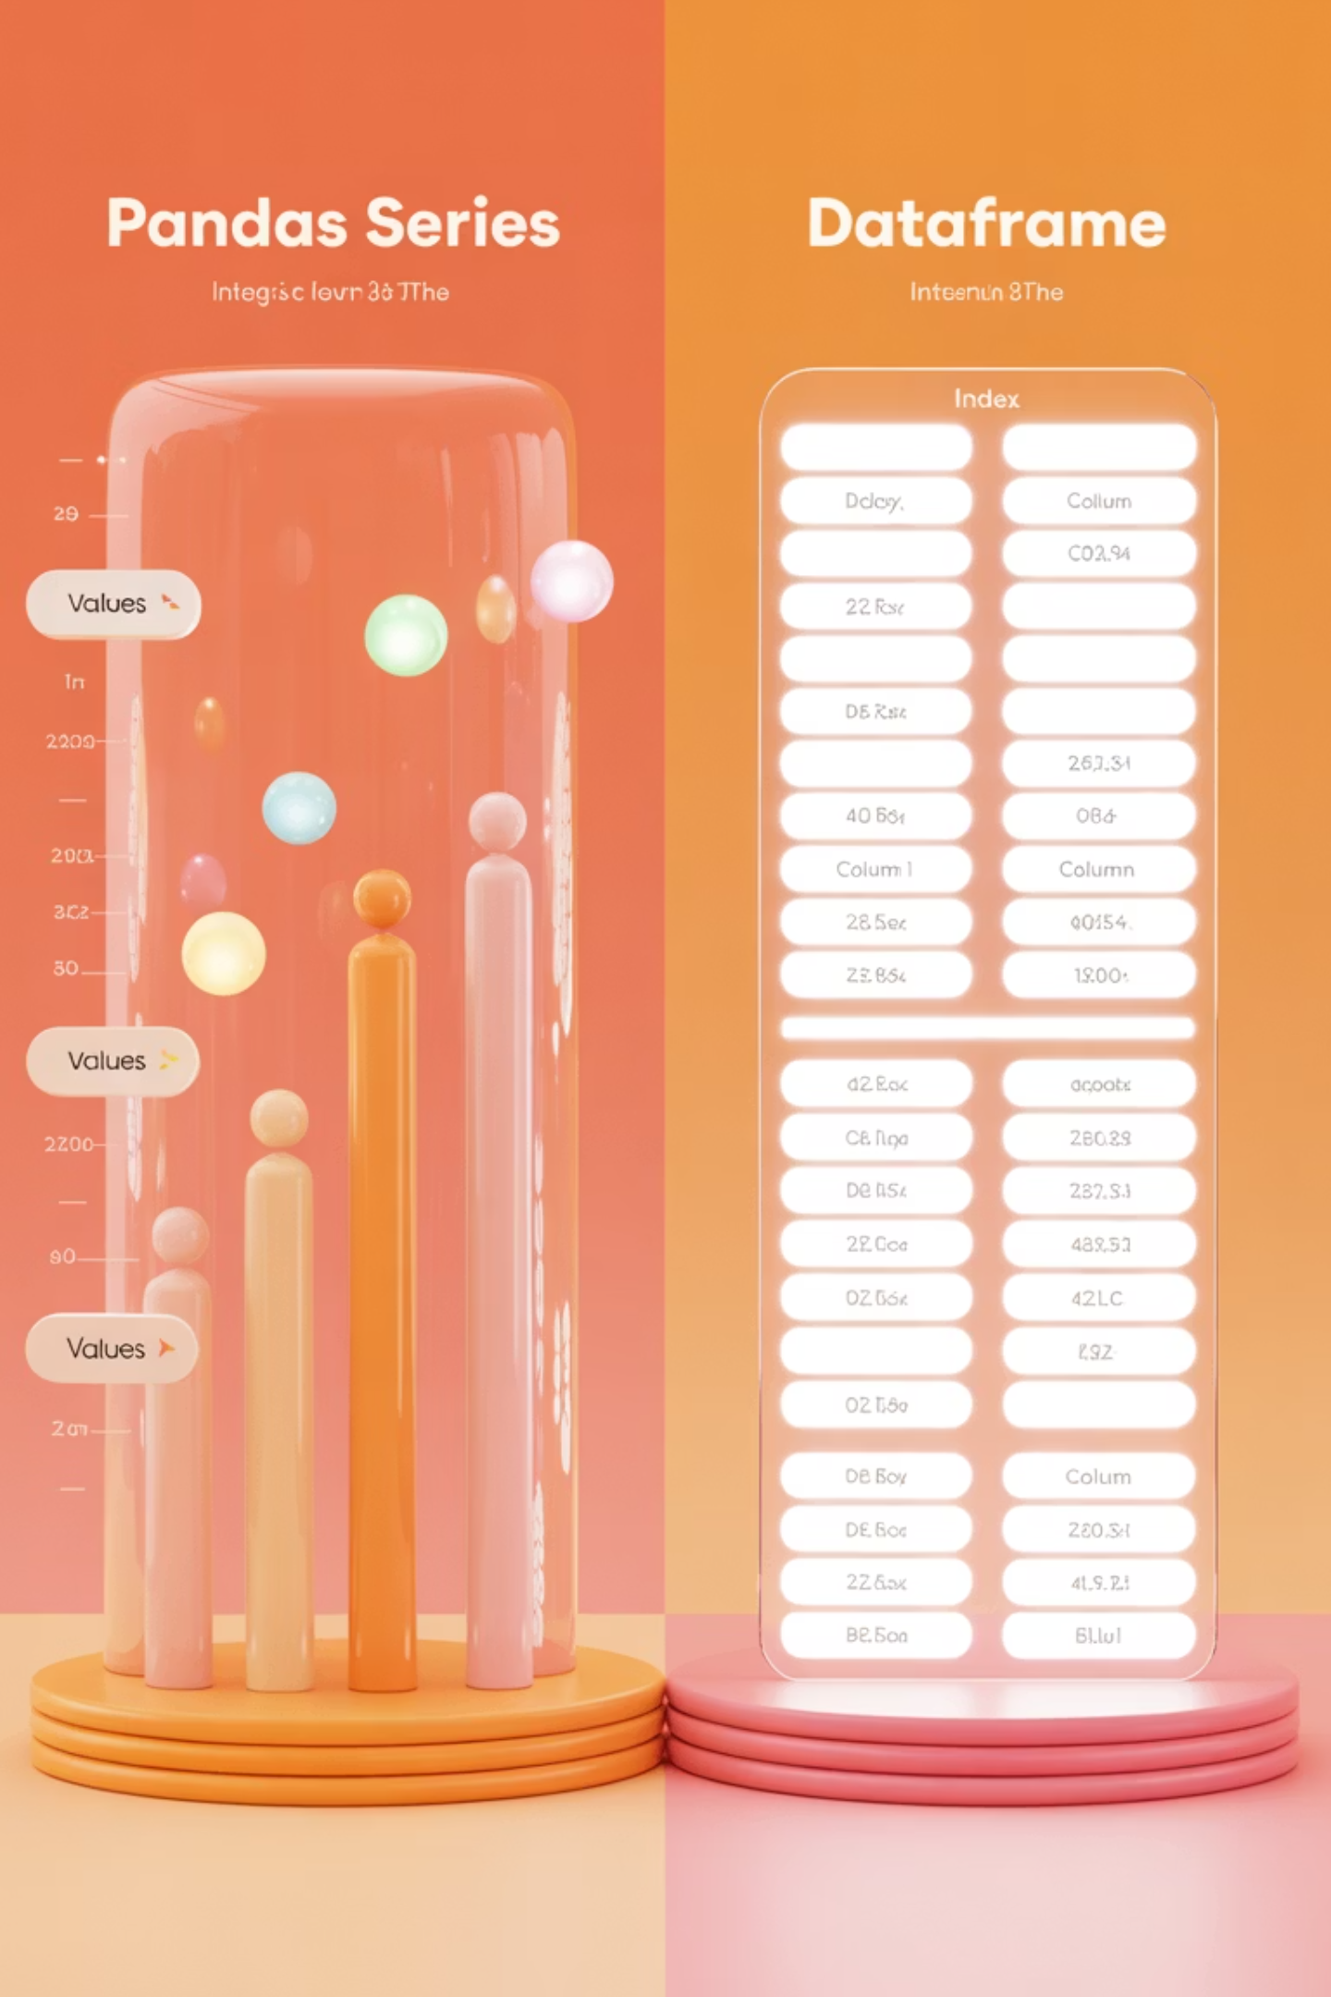
Pandas' Core Data Structures
Series
DataFrame
One-dimensional labeled array (like a single Excel column)
Two-dimensional structure (rows × columns)
Stores data of one type
Like an Excel sheet or SQL table
Has both values and an index
Can store multiple types of data (int, float, string)
Example: Marks of a student in 3 subjects
Example: Student records with Name, Age, Marks

Slide 4
Essential Pandas Operations
Write Data
Process Data
Export to CSV, Excel, SQL and other formats
Read Data
Filter rows by conditions, sort by values, calculate statistics
Import from CSV, Excel, SQL, JSON and other formats
df.to_csv('results.csv')
filtered = df[df['Age'] > 30]stats = df.describe()
df = pd.read_csv('data.csv')
These fundamental operations form the foundation of data analysis workflows, enabling you to transform raw data into actionable insights.

Slide 5

Real-World Pandas Applications
HR Analytics
Education
Financial Services
A company HR exports employee data → analyze salaries by department, identify pay gaps, track retention rates, and optimize workforce planning.
A teacher exports student exam results → find top/bottom scorers, analyze performance trends, identify struggling students, and adjust teaching methods.
A bank processes transaction logs → detect fraud patterns, analyze customer spending habits, identify market trends, and optimize service offerings.

Slide 6


Getting Started with Pandas
Key Takeaways
Next Steps
Pandas transforms Python into a powerful data analysis environment
Install pandas: pip install pandas
Its Series and DataFrame structures handle most data needs
Import it: import pandas as pd
Basic operations (read, filter, sort, describe, write) solve many problems
Try with your own data!
Applications span across industries and use cases
Start with simple data manipulation tasks and gradually build your skills to tackle more complex analysis challenges.

